Slide 1
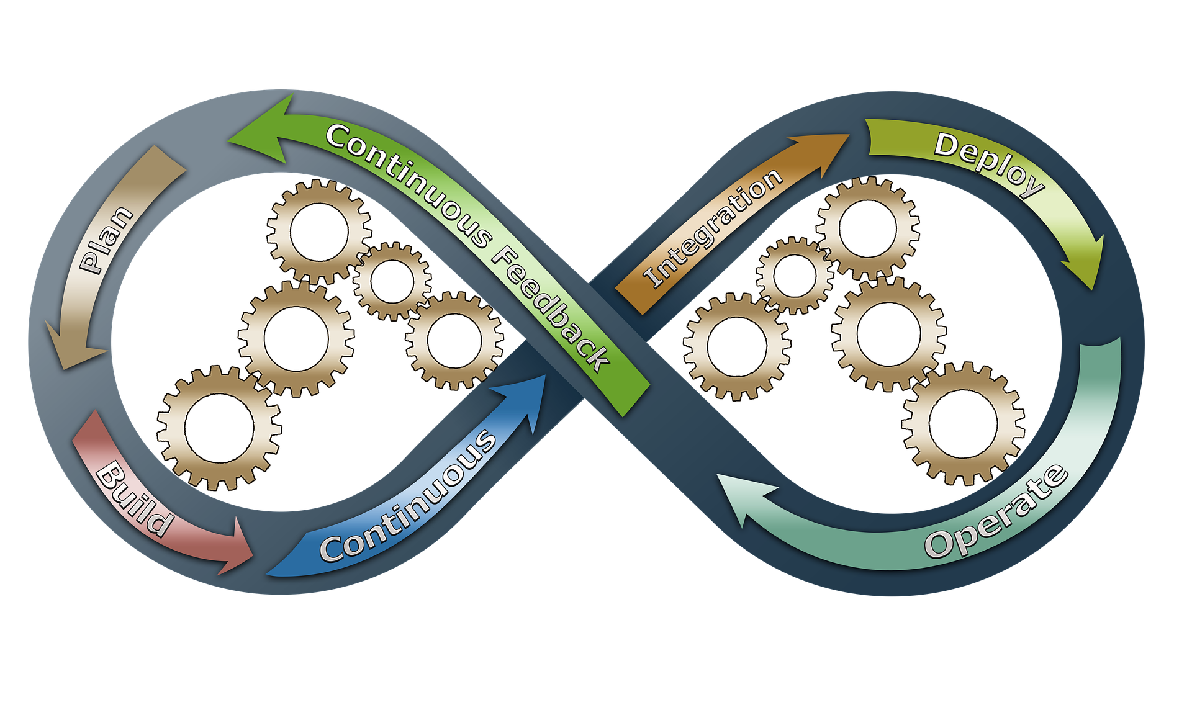
DevOps Tools and Services on AWS

Slide 2
AWS Refresher
EC2
S3
VPC
Lambda
Cloudformation
Cloudwatch
IAM and security
SNS

Slide 3
Waterfall, Agile and DevOps
https://www.thoughtworks.com/insights/blog/path-devops
https://www.guru99.com/waterfall-vs-agile.html
https://www.guru99.com/agile-vs-devops.html

Slide 4
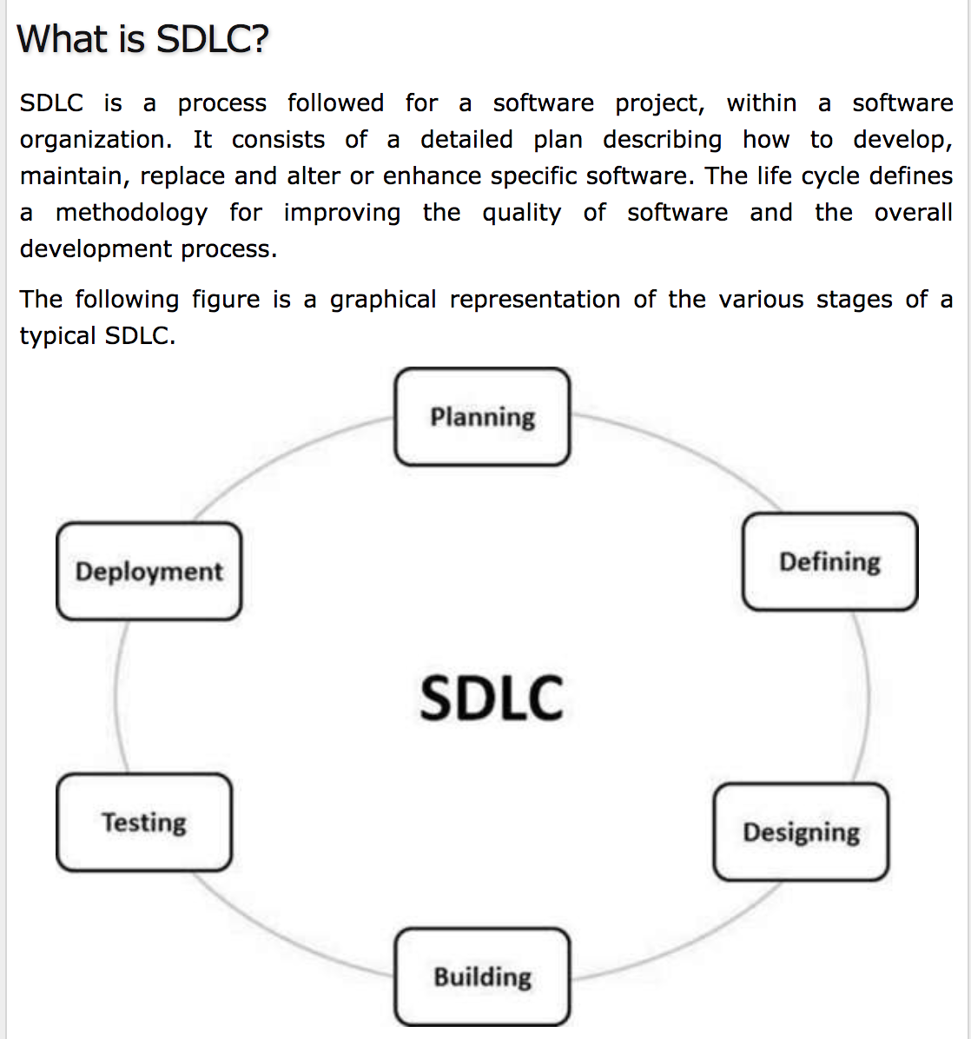
SDLC

Slide 5
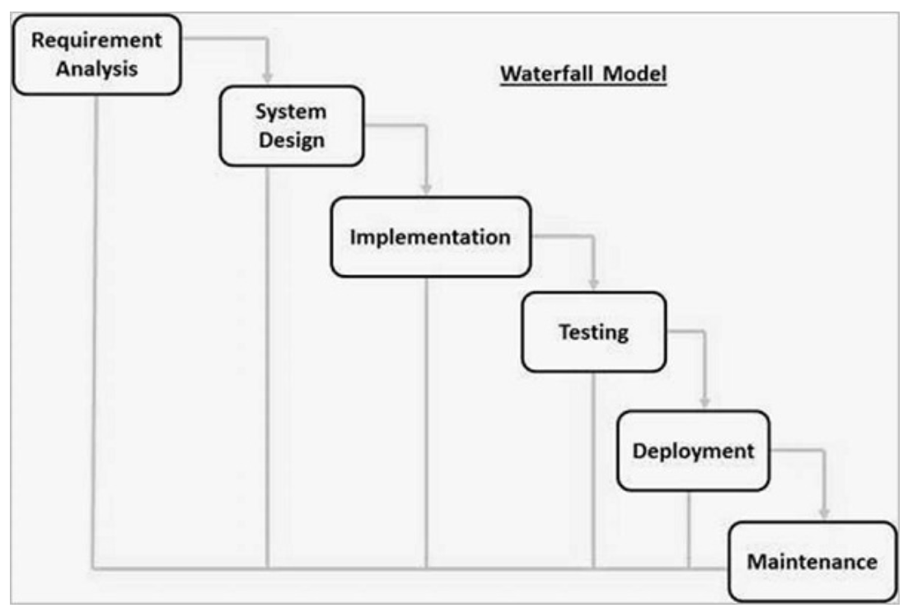
Most IT Software delivery in the Old days
Waterfall method:
There is no scope of changing the requirements once the project development starts.

Slide 6
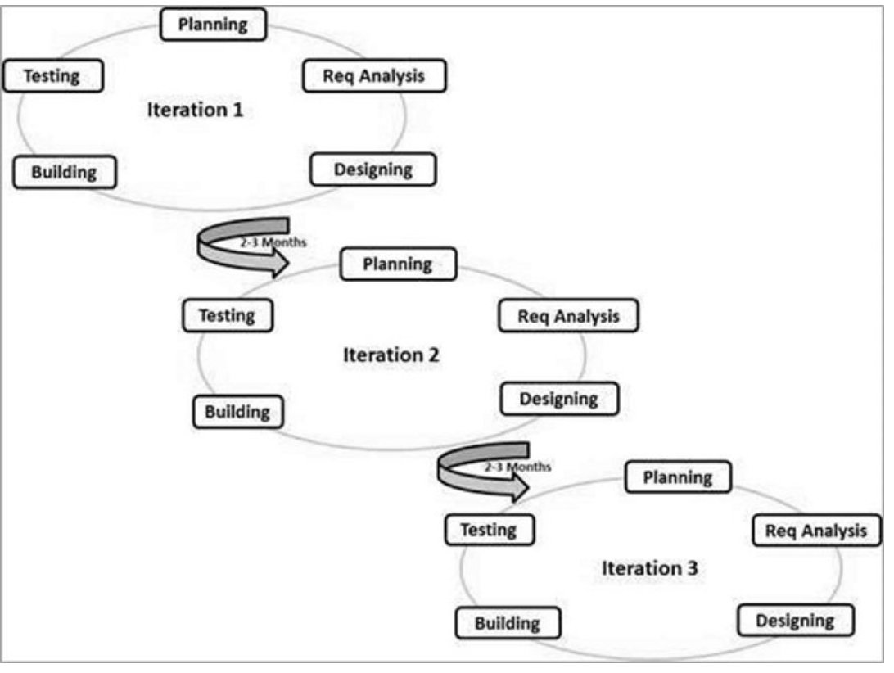
Agile SDLC
Agile is quite a flexible method which allows changes to be made in the project development requirements even if the initial planning has been completed.

Slide 7
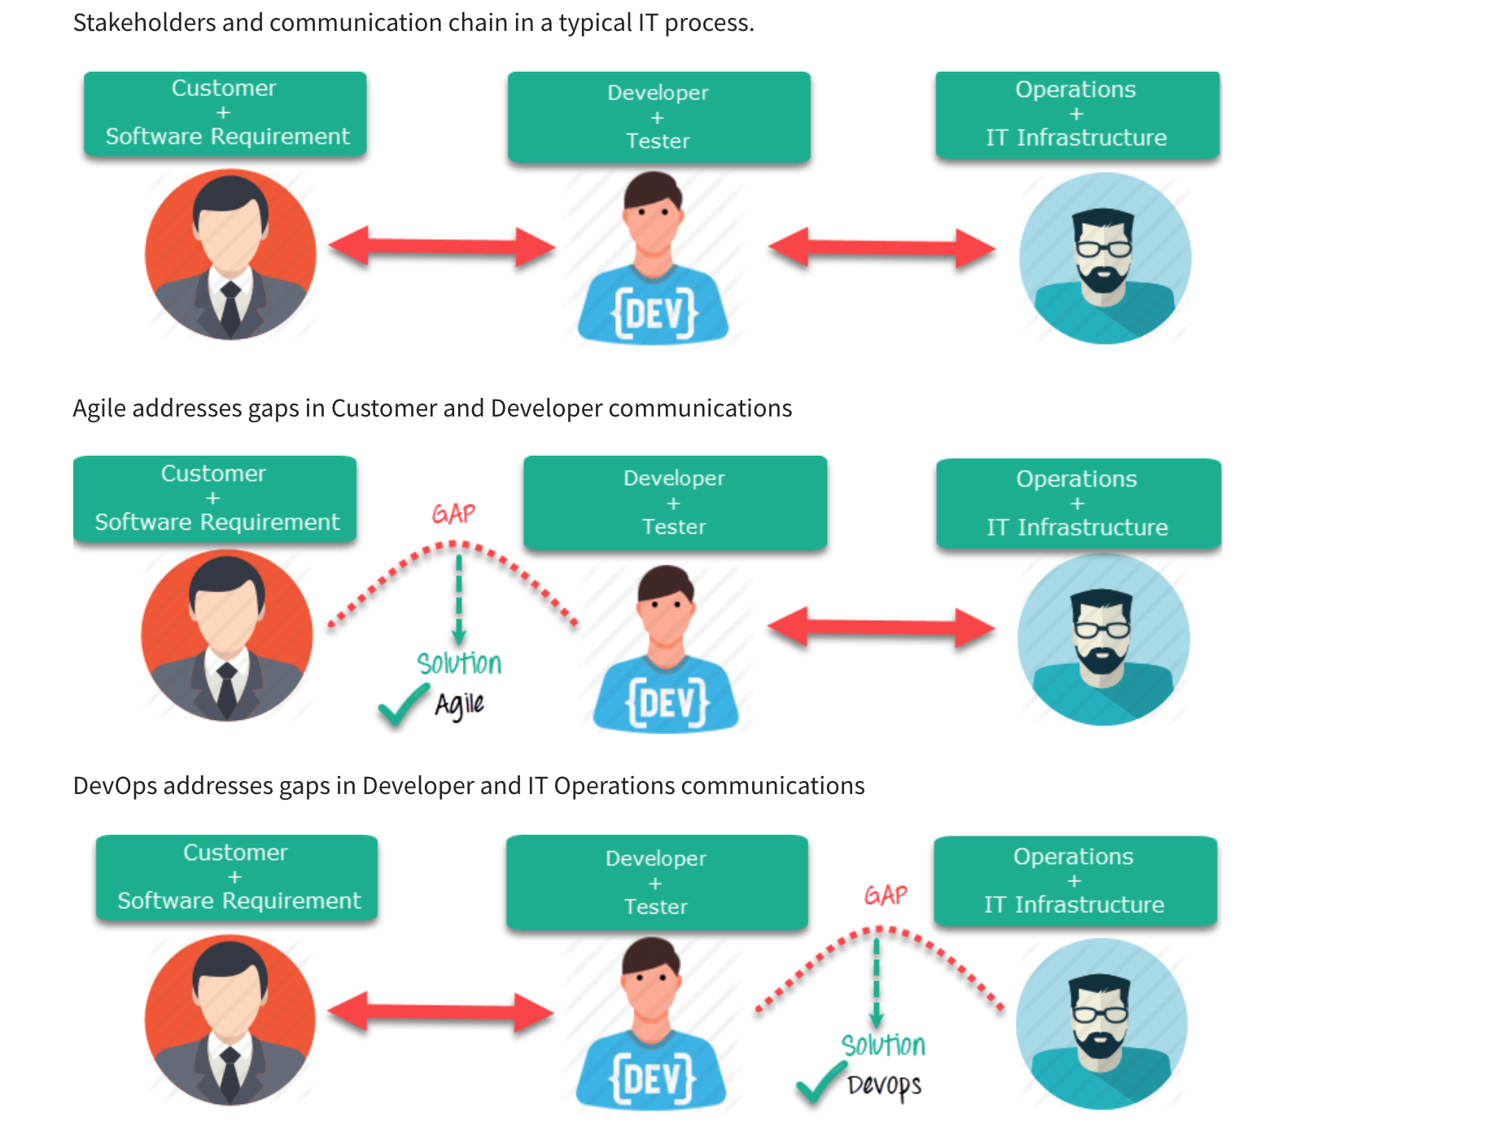
Waterfall, Agile, Devops
Agile methods brought shorter cycles and faster integration of codebase.
Still, code wasn’t in production, it was just being integrated.
Devops solves this problem.

Slide 8
What is DevOps
DevOps is the combination of cultural philosophies, practices, and tools that increases an organization’s ability to deliver applications and services at high velocity: evolving and improving products at a faster pace than organizations using traditional software development and infrastructure management processes. This speed enables organizations to better serve their customers and compete more effectively in the market.

Slide 9
What Does a DevOps Culture Look Like?
Even with the best tools, DevOps is just another buzzword if you don't have the right culture.
The primary characteristic of DevOps culture is increased collaboration between the roles of development and operations. There are some important cultural shifts, within teams and at an organizational level, that support this collaboration.
Developers and Ops team are co-located
Share responsibilities to get things done & Maintain systems
Don’t blame each other , work together to solve problems
Automate to focus on high value tasks
https://www.ca.com/en/blog-automation/what-is-devops-culture.html
https://martinfowler.com/bliki/DevOpsCulture.html

Slide 10
DevOps
The DevOps movement is focused on delivering software faster and more efficiently, without breaking things as often. To meet these goals, businesses need to change organizational culture and structure, as well as the tools and processes they use.
Developers and Operations team work together. Communicate well . This enables software to be delivered faster.

Slide 11
DevOps Introduction Reference
https://aws.amazon.com/devops/what-is-devops/

Slide 12
CONTINUOUS INTEGRATION
Continuous Integration (CI) is a development practice that requires developers to integrate code into a shared repository several times a day. Each check-in is then verified by an automated build, allowing teams to detect problems early.
By integrating regularly, you can detect errors quickly, and locate them more easily
Reference: https://www.thoughtworks.com/continuous-integration

Slide 13
CONTINUOUS DELIVERY
Continuous Delivery is a software development discipline where you build software in such a way that the software can be released to production at any time.
You’re doing continuous delivery when:
Your software is deployable throughout its lifecycle
Your team prioritizes keeping the software deployable over working on new features
Anybody can get fast, automated feedback on the production readiness of their systems any time somebody makes a change to them
You can perform push-button deployments of any version of the software to any environment on demand
https://martinfowler.com/bliki/ContinuousDelivery.html

Slide 14
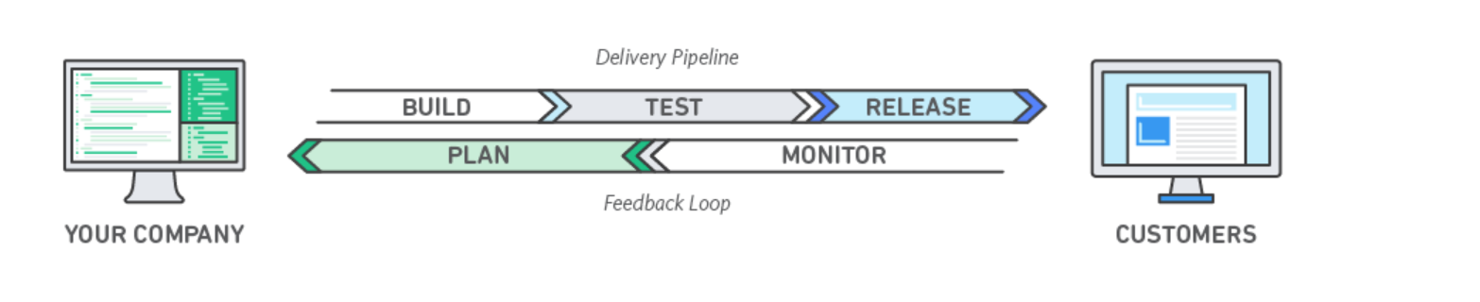

Slide 15
DevOps Services we’ll look at
Infrastructure as code:Cloudformation ( Day 1)
Infrastructure as code: Terraform
Monitoring and Logging: Cloudwatch Metrics + Logs
SCM: Git and Github
Serverless Automation: AWS Lambda
Configuration Management: Ansible
Continuous Integration: Jenkins
ChatOps: Slack
Alerting : SNS
API Automation: AWS Command Line Interface, boto3 AWS SDK
Containers: Docker

Slide 16
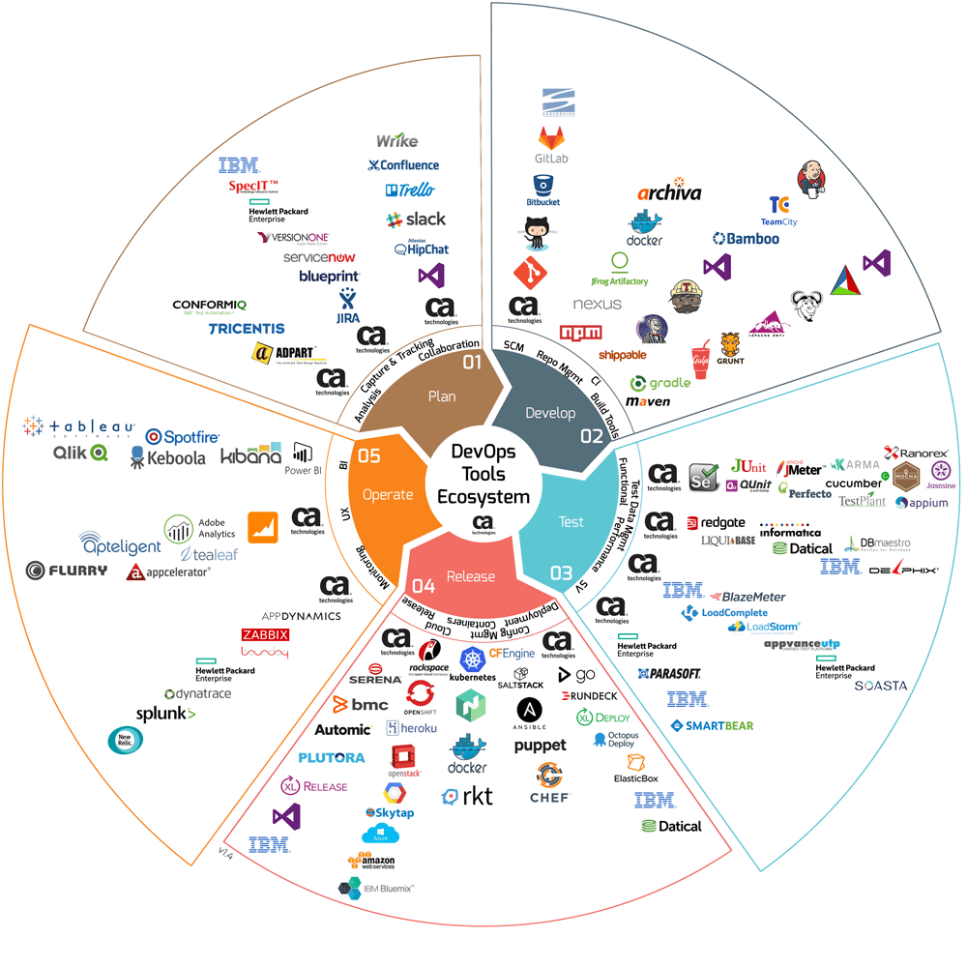
https://dzone.com/articles/the-ultimate-devops-tools-ecosystem-tutorial-part-2

Slide 17
Every companies have different combo of tools
Most of the tools in the previous slides are open source. We can freely experiment. There are paid alternatives that abstract a lot of management.
A lot of companies combine free and paid tools.

Slide 18
Intro to git
What is git?
https://git-scm.com/book/en/v1/Getting-Started-Git-Basics
Why use git?

Slide 19
LAB 1:
Let’s create a git repo. And push to a remote origin.
Create a github account
Create a repo and clone it
Add some files locally
Stage changes, Commit, Push to remote Repo

